Slide 1
Project Management System
06. Atharv Arun Kulkarni
07. Prajwal Prakash Kulkarni

Slide 2
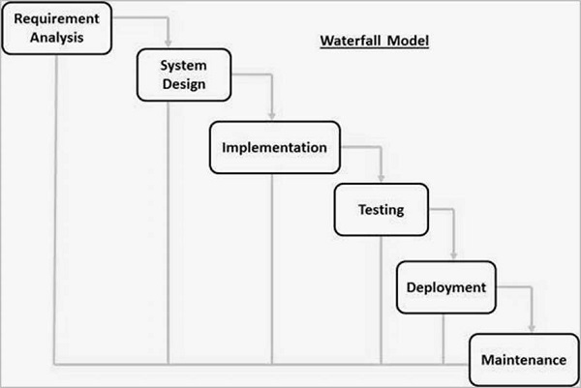
Process Modal :
This project uses a waterfall process modal. The waterfall approach was the first SDLC Model to be used widely in Software Engineering to ensure the success of the project.

Slide 3
Process Modal :
Requirement Analysis: By developing this system we are trying to take the project of the user. The basic requirement is that this software is able to handle multiple projects created by users and that particular project’s problem. This system is also able to generate reports of the project.
System Design: After gathering the requirements from the user we started making user interface pages that make more sense and are more user-friendly. The User interface must be mobile-friendly. And also designed a database. The database includes multiple tables will discuss them in the database section.
Implementation: After designing the User and interfaces and database design it’s time to implement it. Each unit is developed and tested for its functionality, which is referred to as Unit Testing.
Testing : Each unit is developed and tested for its functionality, which is referred to as Unit Testing. For testing purpose we have implemented white box testing. With inputs from the system design, the system is first developed in small programs called units, which are integrated in the next phase.

Slide 4
Process Modal :
Deployment: After completing the requirement of the user then we can deploy on the server or on other resources.
Maintenance: There are some issues that come up in the client environment. To fix those issues, new updates or bug-fixing updates are released. Also to enhance the product some better versions are released. Maintenance is done to deliver these changes in the customer environment.

Slide 5
Objectives And Scopes:
1. Reduction of lead-times
2. Inventory reduction (e.g. capital reduced by x $’s)
3. Simplification of the organization (e.g. reduce manufacturing steps by x %)
4. Increase flexibility (e.g. production within x days after customer order)
5. Identify potential bottlenecks(the one thing that stops the progress of the business) in your process and fix them so work can flow through it cost-effectively at an optimal speed or throughput.
1. Majorly The Project Management System’s goal is to get coordination between the members of the persons.
2. Project Management System Kanban represents a visual way to create, track, and manage tasks and workflows.
3. The project deliverables are the things where the actual exchange of the work in terms of money is measured, are involved.
4. The main scope of the system is to determine the costs and deadlines of a certain project.

Slide 6
Limitations :
Home Page :
1. Users cannot add content in In-progress, verify, or done sections like the do-it section.
2. User cannot comments on content that encourage them to communicate properly
Project Page :
1. User cannot remove or delete projects from the list
2. Role-wise rights are not present anyone who has the username and password he/she can access the dashboard and other content
Report Page :
1. When content is not added to the project then it will display NaN in the progress bar
2. The user cannot see what content is present in which section
FAQ Page :
1. User cannot add/ask new question

Slide 7
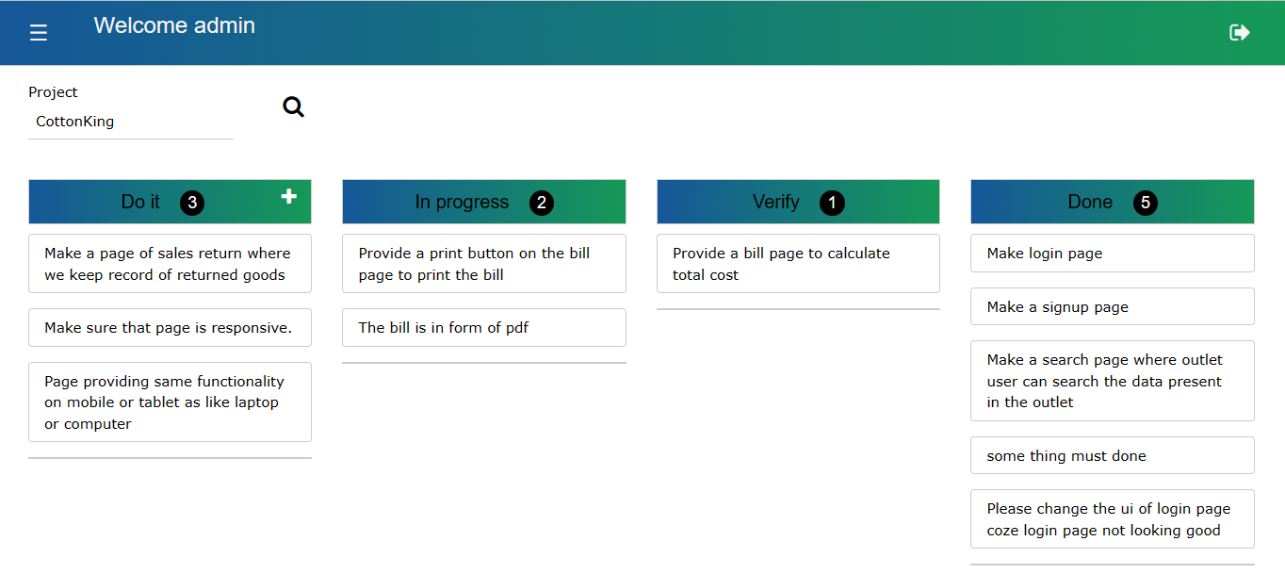
User Interface Of Home Page:

Slide 8
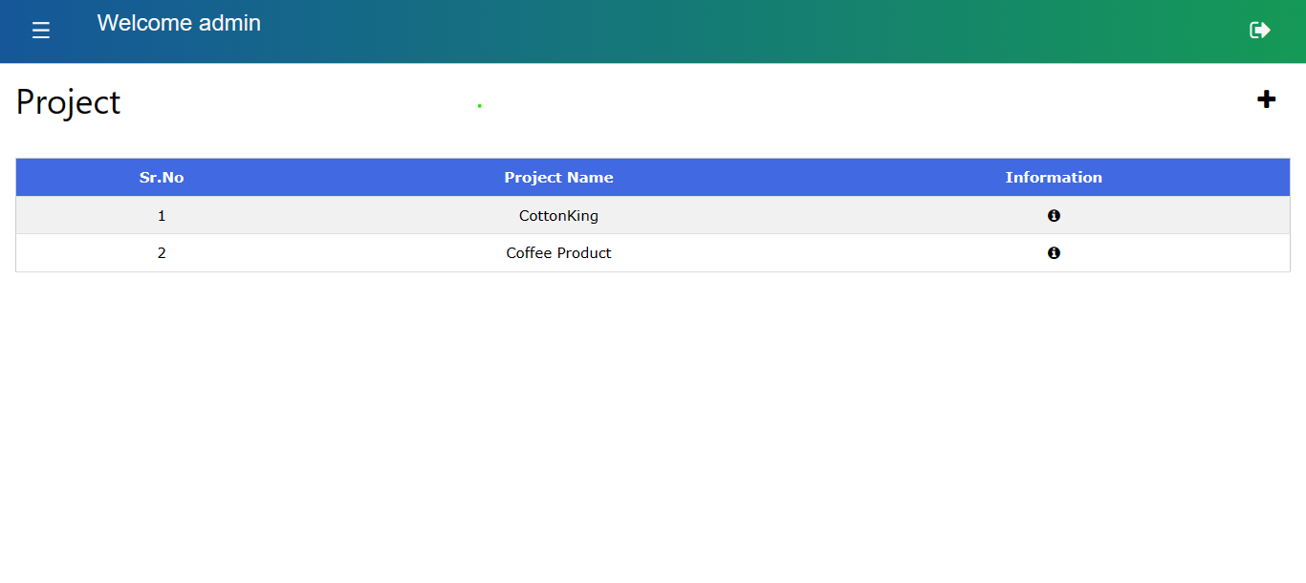
User Interface Of Project Page:

Slide 9
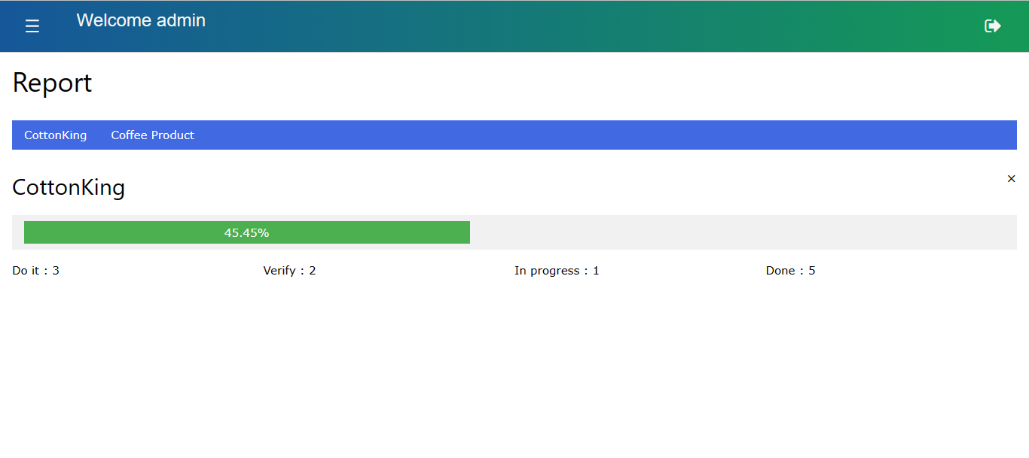
User Interface Of Report Page:

Slide 10
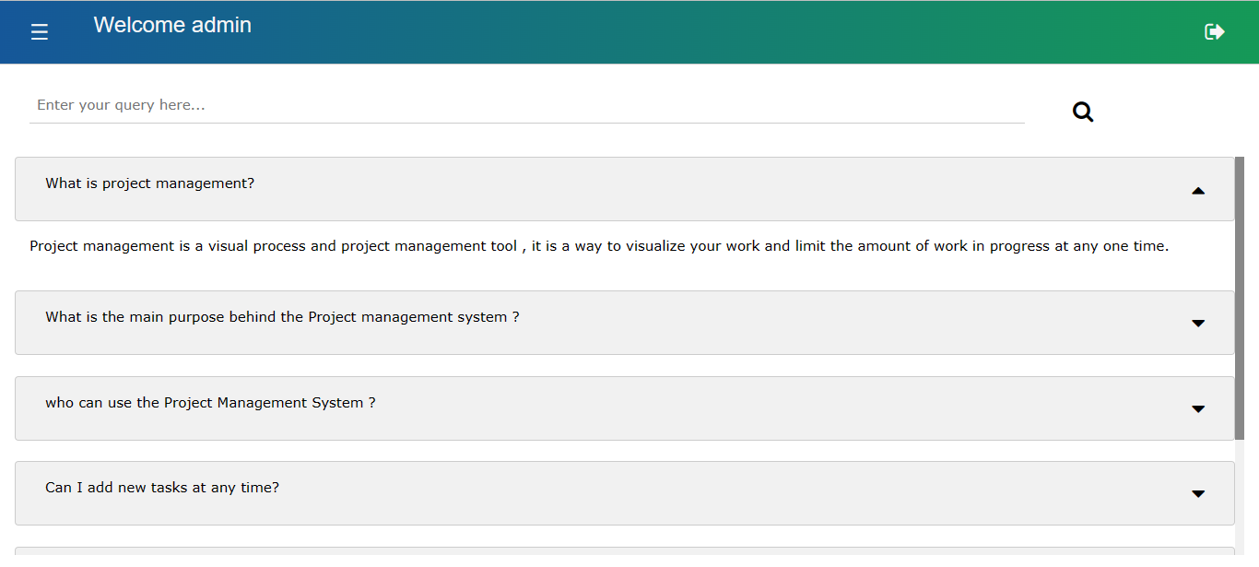
User Interface Of FAQ Page:

Slide 11
Table No. 1 : tbl_user
System will use this table to store the username and password added by the user at the time of signup. After storing the system will use this data at the time of login to identify which user is trying to login.
If user’s record present in this table and user have entered correct username and password then system will redirect user to home page otherwise system will alert the user.

Slide 12
Table No. 2 : tbl_project
In this table system is storing the project name, its description, when project is added and user id to identify which user is added to.

Slide 13
Table No. 3 : tbl_content
In this table system will store problems added by the user for that project. This problem fetches the system when the user clicks on the search button which is present on the homepage of the system. When user moves the content from one section to another section the system will update only the section_holding_ids column.

Slide 14
Table No. 4 : tbl_count
In this table, the system is storing the count of do it, in progress, verify, do for that project. After inserting a row we will update the count of do it, in progress, verify and do related to that particular project added by the user.

Slide 15
Table No. 5 : tbl_faq
In this table system stores the questions and answers. The system will fetch this data when the user lands on the help page and display only questions. When the user clicks on the drop button then the system will display the answer to that question.

Slide 16
Stored Procedure
Parameter List :
IN `p_userid` INT, IN `p_content` VARCHAR(100), IN `p_projectname` VARCHAR(20), IN `p_projectdescription` VARCHAR(1000), IN `p_projectid` INT, IN `p_sectionholdingid` TINYINT, IN `p_contentid` INT, IN `p_datetime` DATETIME, IN `p_mode` TINYINT, INOUT `out_parameter` INT
Using this stored procedure to handle data more efficiently, to get better performance, higher productivity, scalability, and maintainability.

Slide 17
Stored Procedure
Working of Stored Procedure when the mode is 1 :
1. Insert the new record of the content into table tbl_content
2. Update the count of do it by 1 in the table tbl_count
Working of Stored Procedure when the mode is 2 :
1. Update the section holding id that content in the table tbl_content
2. Update the count related to that particular project in the table tbl_count
Working of Stored Procedure when the mode is 3 :
1. Insert the new project into table tbl_project
2. Insert the record into tbl_count for that project

